Slide 1

ProSys (Final year project management system)
Supervised By: : Ridah Fatima Mudassir

Slide 2
Project Team
Walid Ahmed(12422)
Muhammad Sami ullah Qureshi(12520)
Alizain Aziz(12253)

Slide 3
Table of Content
Project Scope
Problem Statement
Solution
System
Requirements Summary
Functional Requirements
Non-Functional Requirements
Design
Implementation
Achievements
Future Work/Improvements
Conclusion

Slide 4
Project Scope
Final Year Project Management System is web-based solution designed for Iqra University.
Manages final year projects.
All activities/processes involved in final year projects.

Slide 5
Problem Statement
Students don’t have any idea of previous projects ideas, status and information
No platform containing Final Year Project repository.
Many of the projects fail because of barriers of communication between supervisor and students.
Students mostly face the problem of meeting the supervisor, Managing time to meet supervisor.

Slide 6
Solution
A customized solution should be there to handle all the Final Year Projects lifecycle
A system should be there to
Manage all final years projects lifecycle
Maintain previous projects repository
Should be available online

Slide 7
SYSTEM

Slide 8
Requirements Summary
List of Different Users
Student
Supervisor
Coordinator
Functional & Non Functional Requirements

Slide 9
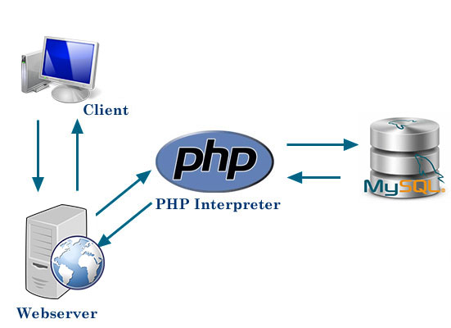
Design
Notes:
Design:
Include a deployment diagram that provides overview of the entire system (hardware / software components)

Slide 10
Development Tools & Technologies
PHP: For server side scripting language
MySQL: as Database
JavaScript: client side scripting
JQuery, Ajax: for easy form validations and other functionalities
Bootstrap, media queries :for responsive, mobile-first web site

Slide 11
Libraries / Components / Web Services
SendGrid API
Bootstrap Validator
Bootstrap Datetime picker
Bootstrap Components
Fonts Awesome
Admin LTE Theme

Slide 12
Achievements

Slide 13
Functional Requirements
Create batch
Project Repository
Initiate a group or Join an existing group
Choosing Supervisor
Timeline
Batch Tasks
Meeting Request
Register and Manage users(Faculty, students)
Notification
Send E-Mail
Weekly Report
Student Grading

Slide 14
Non-functional Requirements
The system is available 24/7 except in the case of unexpected condition like failure of internet etc.
System is user friendly, responsive and it is designed so that interaction of user will be maintained.
Since this system is responsive so users will be able to access from every device with internet connections.
Our system is prone to future changes. There will be a panel to change and set rules (i.e. Maximum members in a group etc.). Users can be added or removed. Records can be edited also.
To avoid failure, we will use server validation using PHP and JavaScript validation on client side. System will also maintain a cloned database so if any failure occur it will be able to restore the database.
To ensure consistency we are using same CSS style sheets on almost all pages.

Slide 15
Achievements
Coordinator Panel
Supervisor Panel
Student Panel

Slide 16
Coordinator Panel
Create Batch
Batch Templates
Batch Task
Batch Settings
Register Student
Register Faculty
Manage batch
Manage Student
Manage Students Groups
Manage Faculty
Manage Student Timeline
Send E-Mail
Project Repository
Grading
Additional Features
Coordinator Profile
Share Idea
View Weekly Reports

Slide 17
Supervisor Panel
Faculty Timeline
Accepts Group Request
Supervise Groups
Send E-Mail
Grading
Additional Features
Faculty Profile
Create Weekly Report
Share New Ideas
Accept or Reject students group notification

Slide 18
Student Panel
Student Timeline
Create Project
Join Group
Choose Supervisor
Group Settings
Set Project Name
Project Templates
Batch Tasks
Group Details
Meeting Request
Send E-Mail
Additional Features
Student Profile
View Weekly Report
View Share Idea
Join Group Request Notification
Batch Task Notification

Slide 19
Future Work/Improvements
• Generating PDF file of the require list in the system
• It should have a built-in meeting module that helps students and supervisors to discuss project online via live meeting
• Discussion platform should be added so any student can get answers from any faculty member
• Students should have access to the Project repository because then students know about the past projects

Slide 20
Conclusion
Final Year Project Management system automates the Final year Projects lifecycle
This solution is made for Iqra University

